Slide 1
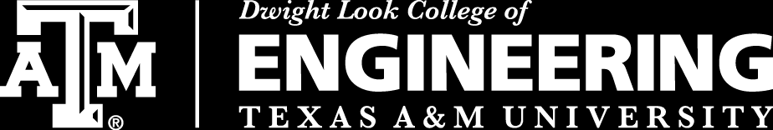
3D Inspection Rover
Team 8
Bi-Weekly Update 3
Sponsor:
Kevin Nowka
TA:
Eric Robles
Team Members:
Chris Dumont
Dalton Hines
Felipe Villegas
Celeste Waters
Notes:
Normal text size and our names are all size 24
Titles are all size 30 except first and last slides

Slide 2
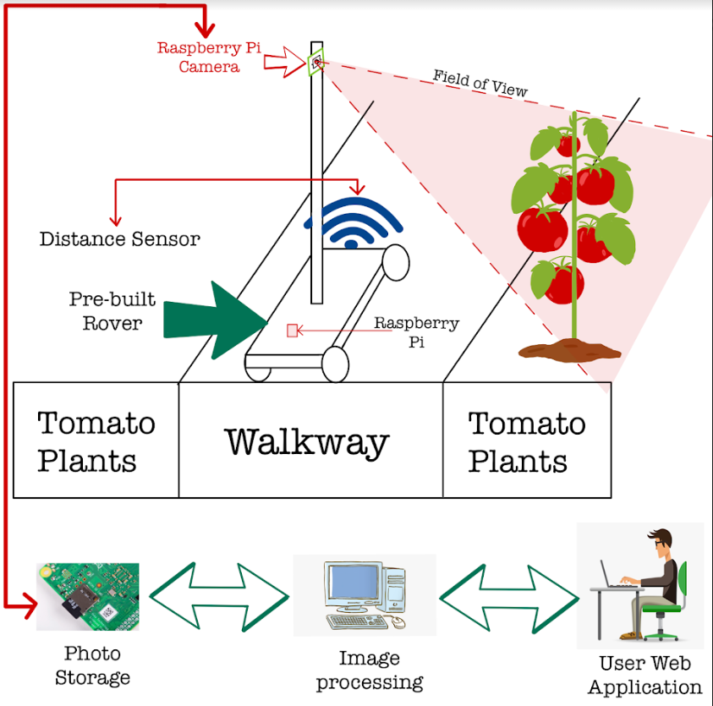
Project Summary
The Problem Is:
Tomato Classification in its current state takes too long
Our Solution Is:
Create a rover that classifies the tomatoes autonomously
Send this data to a database/website that displays yield for the farmer

Slide 3
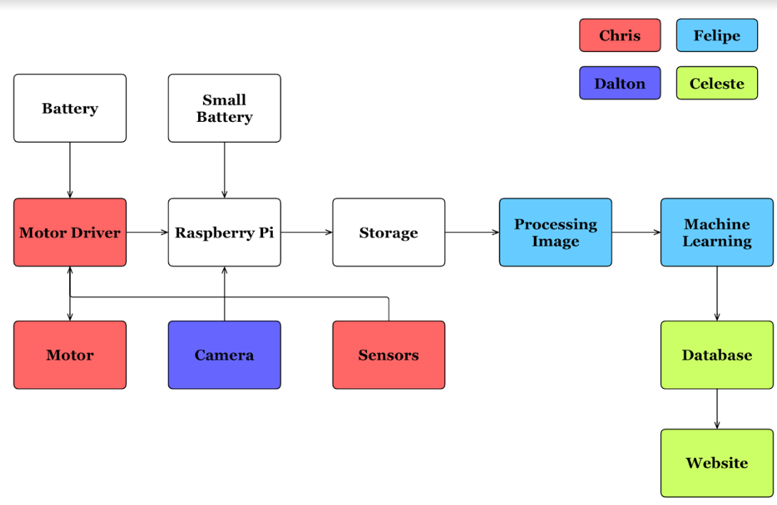
Subsystem Overview
Notes:
Navigation (Red)
Traversing the greenhouse
avoid obstacles in path
Camera Positioning (Purple)
Move Camera up/down mast
Take clear picture of all tomatoes
Image Processing (Blue)
Use machine learning to classify all tomatoes by ripeness
Database/Website (Green)
Save all images
Produce useful charts
Track growth

Slide 4
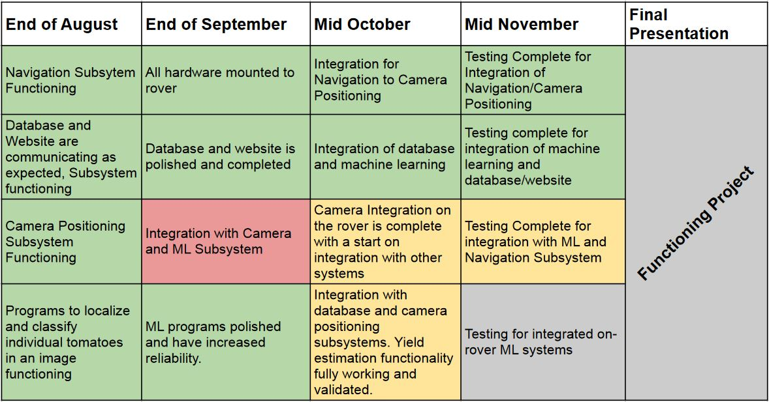
Project Timeline

Slide 5
Navigation & Camera Positioning Integration
Chris Dumont & Dalton Hines
Accomplishments since last presentation ~ 15 Hours each | Plans until next presentation
All circuits soldered Circuits Functioning Code functions properly across subsystems | Circuits mounted to Rover Re-mount distance sensors to rover Test fail cases Assist Felipe and Dalton integration Add aisle count

Slide 6
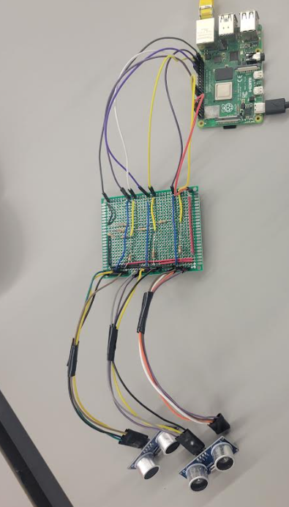
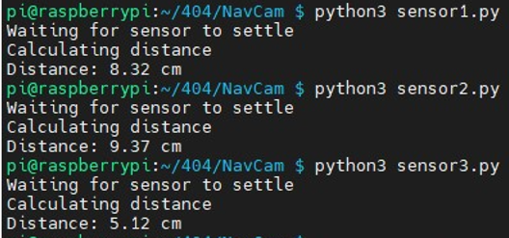
Sensor Circuit Validated
Chris Dumont and Dalton Hines
Distance sensors working properly on soldered board
Now just need mounting to rover

Slide 7
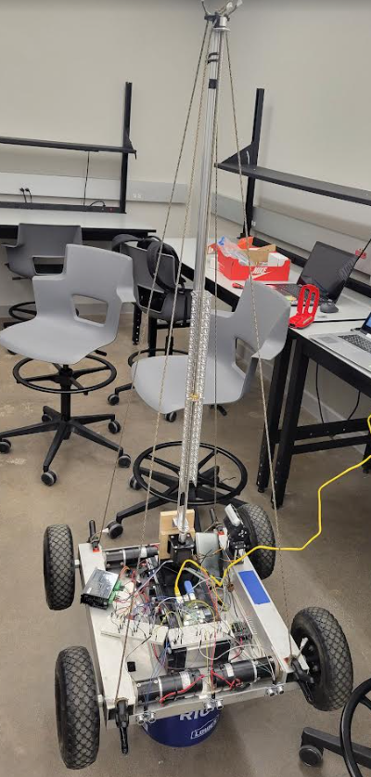
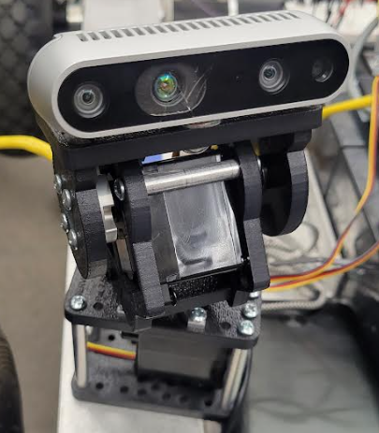
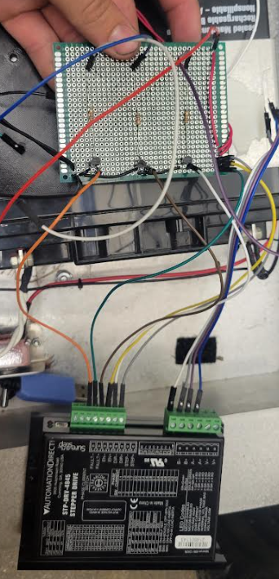
Mast and Gimbal Circuit Validated
Dalton Hines
Circuit properly drives motors on gimbal and mast

Slide 8
Machine Learning Subsystem
Felipe Villegas
Accomplishments since last presentation ~ 20 Hours | Plans until next presentation
Main integration functionality between ML & Database Complete Begun ML & Camera System Integration | Resolve ML-Camera System Integration Bottlenecks Full ML-Camera System Integration

Slide 9
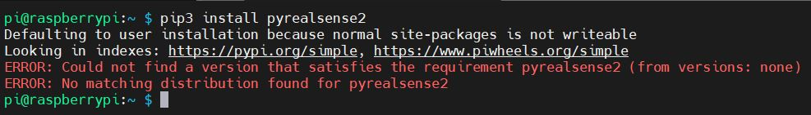
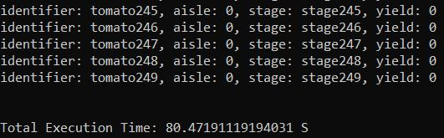
Machine Learning Subsystem
Felipe Villegas
Issue with acquiring necessary libraries on raspberry pi
Alternative installation methods methods needed
Upload Time to database for 250 line of data is ~70 - 80 sec

Slide 10
Website and ML Integration
Celeste and Felipe
Accomplishments since last presentation | Plans until next presentation
Code upload data from local storage to database complete Upload time measurements acceptable | Finalize end of route detection and upload behavior

Slide 11
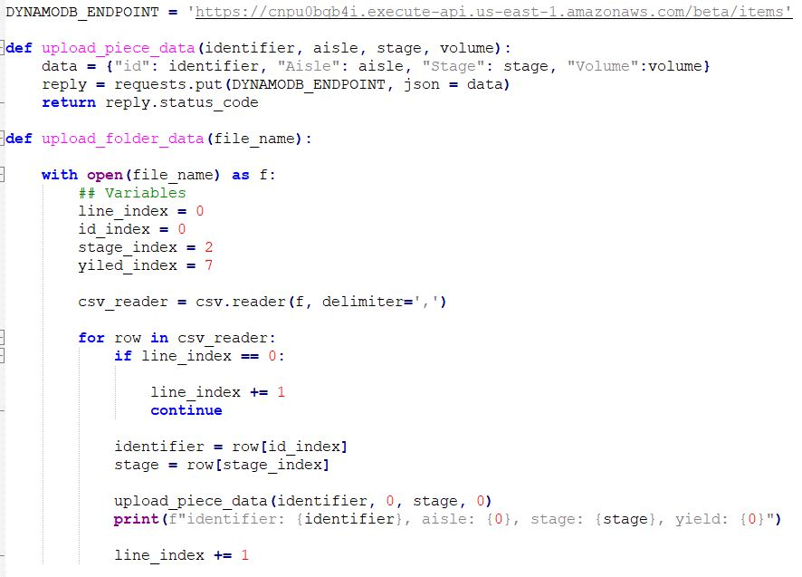
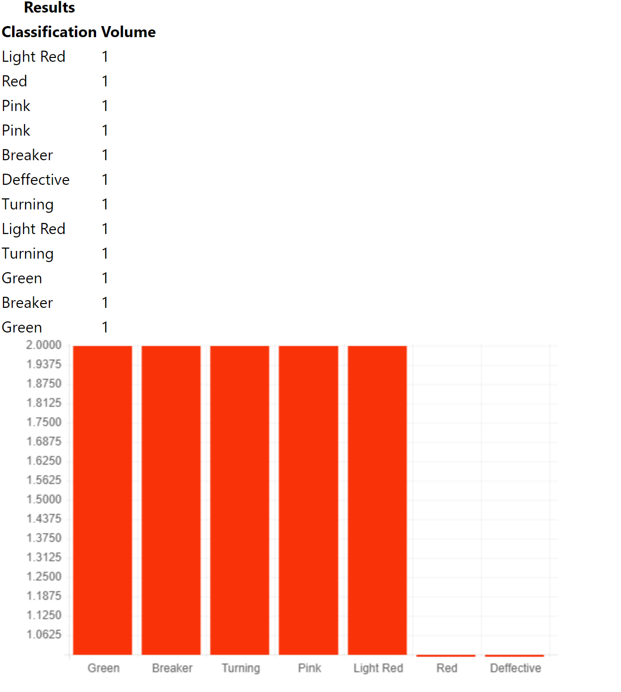
Website and ML Integration
Celeste and Felipe

Slide 12
Database/Website Subsystem
Celeste Waters
Accomplishments since last presentation ~15 hrs | Plans until next presentation
Website auto Generates histograms when given data | Assist integration with Felipe and Dalton Test Fail Cases

Slide 13
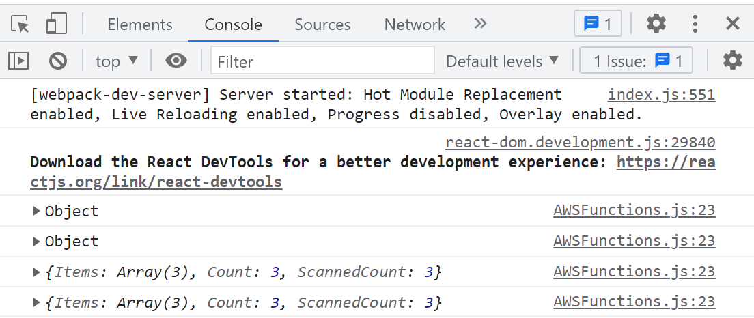
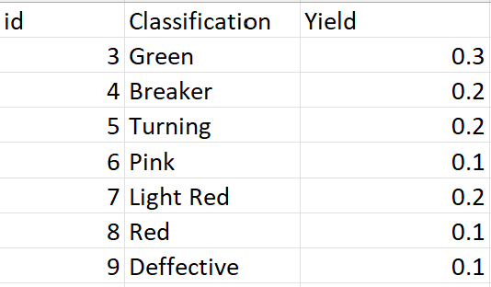
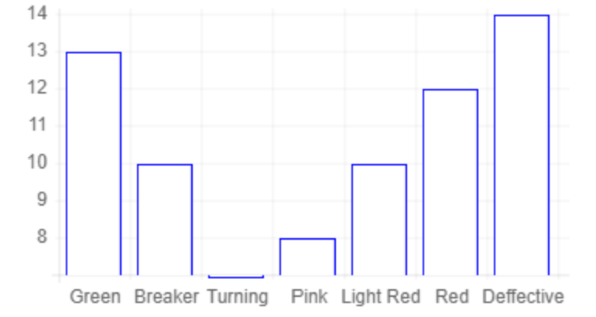
Database/Website Subsystem
Celeste Waters

Slide 14
Parts Ordering Status
Part | Description | Order Placed | Arrived
403 Parts | All Parts needed for 403 | Yes | Yes
C-clamps | Clamp used to secure mast to rover | Available in WEB lab | Yes
Wire | Used to prevent swaying of mast | Available in FEDC | Yes
New Batteries for Rover | Just in case ours die before demo | Yes | No
Longer Camera Cable | Allow full range of motion for camera over mast | Yes | No

Slide 15
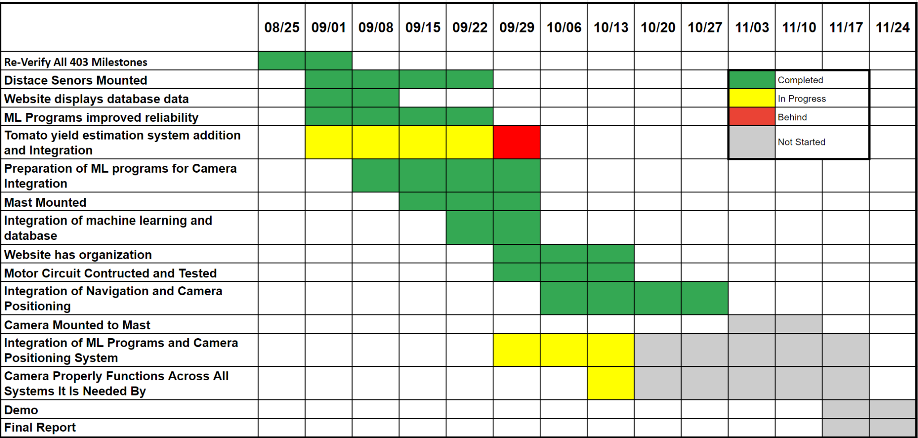
Execution Plan

Slide 16
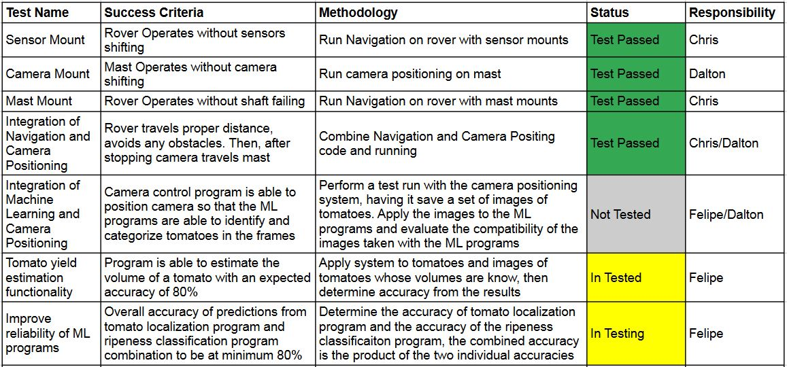

Validation Plan

Slide 17
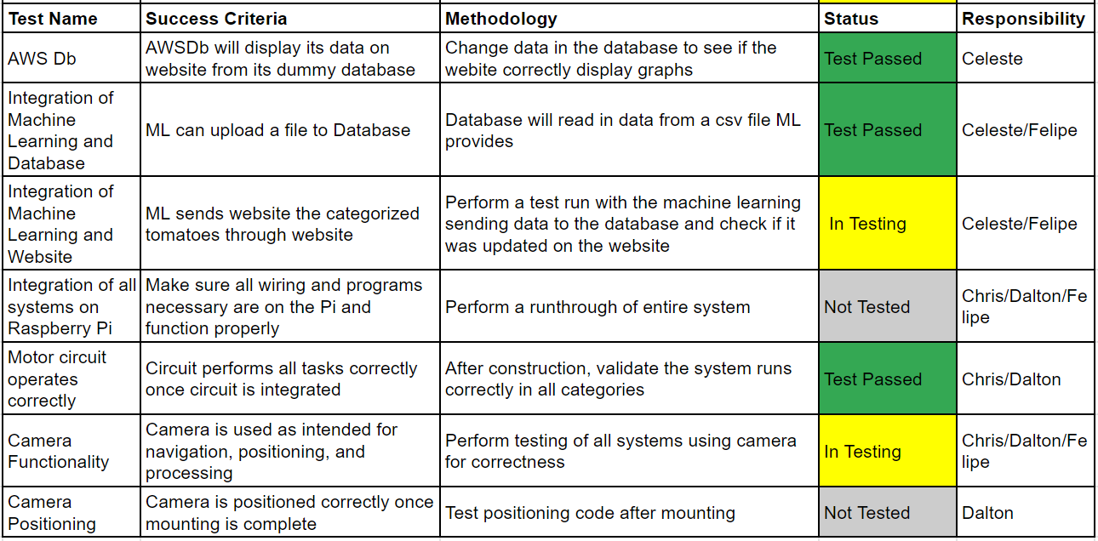
Validation Plan

Slide 18
QUESTIONS

